Slide 1
WASH in Health Care Facilities
Insights from India
Dr. Arundati Muralidharan
Manager – Policy, WaterAid India

Slide 2
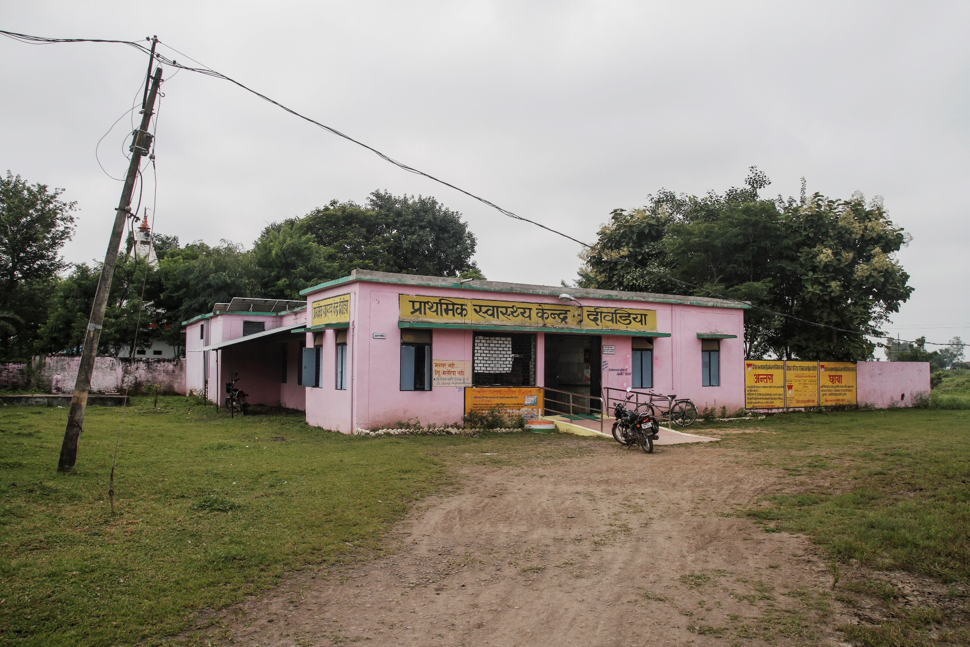
25,743 PHC
5624 CHC
1130 Sub-divisional
764 District Hospitals
75.1% women deliver in health care facilities
- 54.4% in public health facilities
Quality of Care?
Safe, effective, timely, efficient, equitable
and people-centred?
Photo/WaterAid India/Ronnie Sen
Notes:
To improve patient outcomes, health care must
be safe, effective, timely, efficient, equitable
and people-centred6. Deaths and illnesses
from maternal and early neonatal sepsis are
suggestive of substandard quality of care7.
When health care facilities have an unhygienic
environment, with inadequate supply of running
water and handwashing facilities, and poorly
maintained or dysfunctional toilets, women
may avoid or delay seeking care and are
likely to leave such facilities sooner than they
should after delivery8. Health care providers
working under such conditions are unable to
maintain hygiene and prevent infections. Such
circumstances place a new mother and her baby
at the risk of sepsis, which, when untreated,
can be life-threatening.

Slide 3
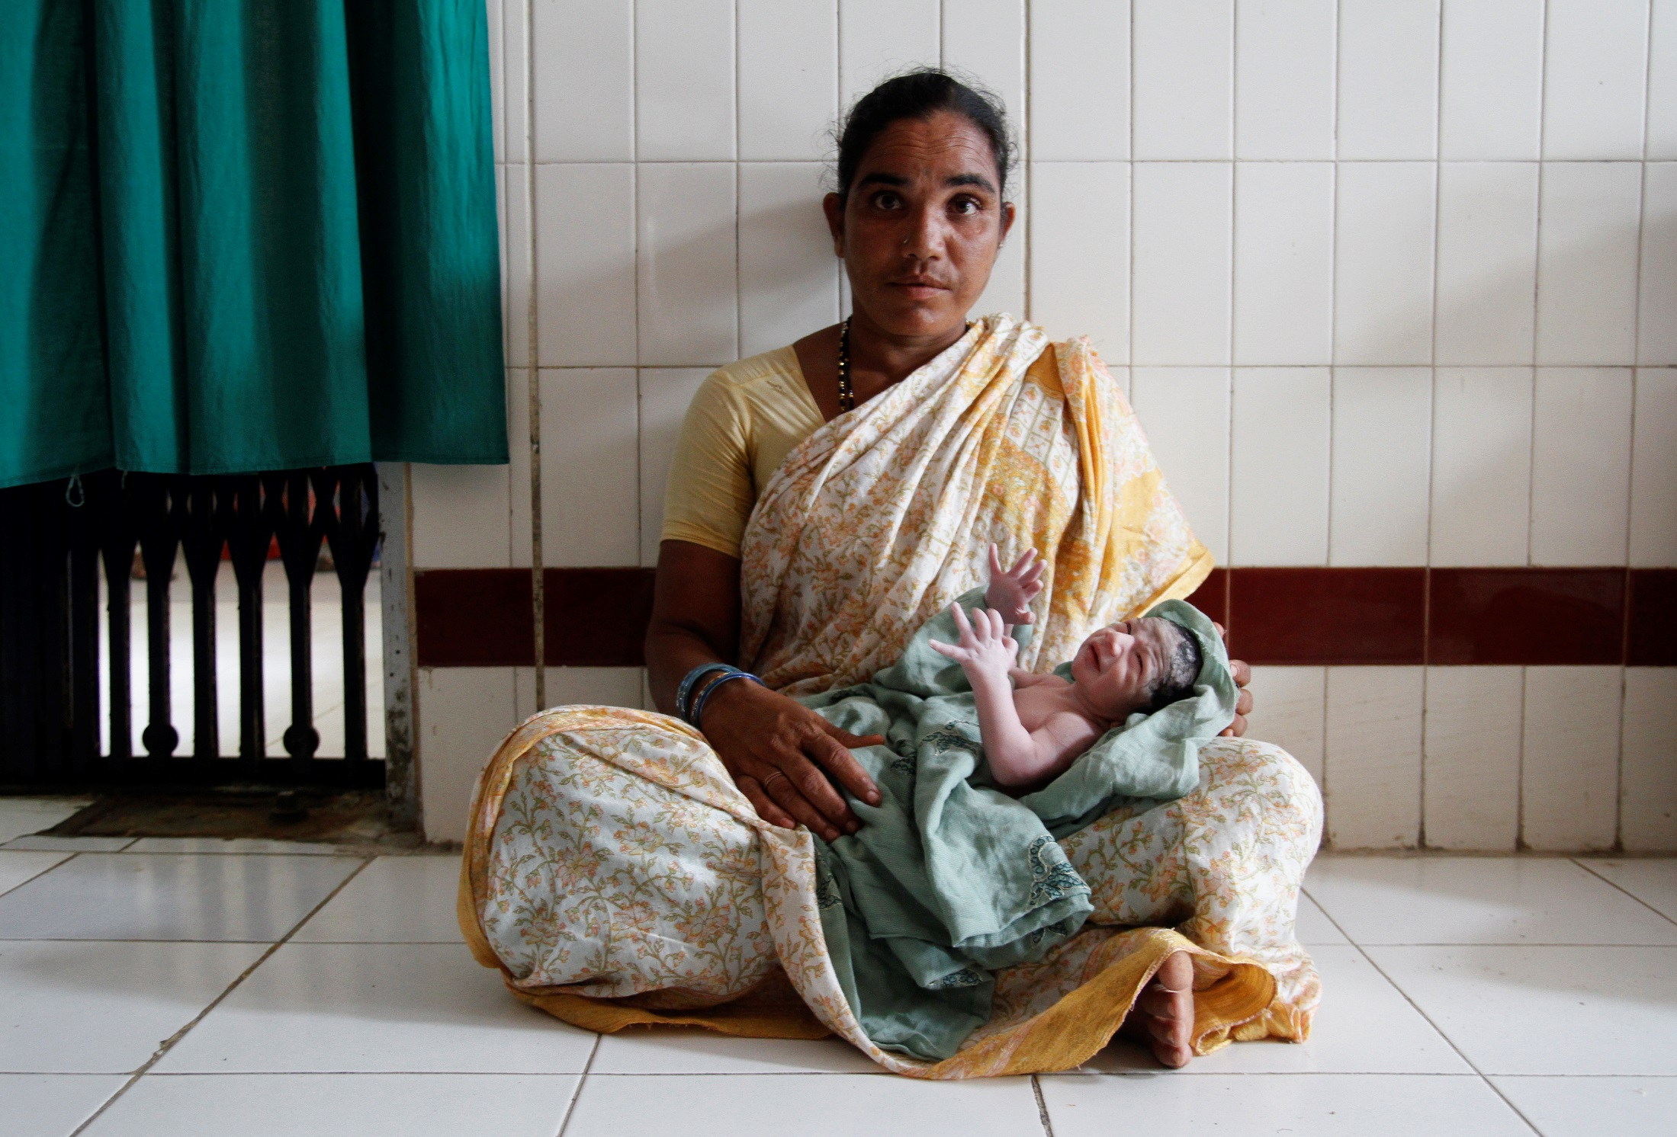
Neonatal mortality rate:
28 per 1000 live births
Maternal mortality ratio:
130 per 100,000 live births
Sepsis a leading cause of infection and death
AMR a growing concern
9.2% facilities lack water
45% facilities lack sanitation
41.7% need hygiene facilities
Photo/WaterAid India/Ronnie Sen

Slide 4
India’s approach to integrating WASH in health – a health systems approach
Leadership & governance
Improved health
Level and equity
Access, coverage
Health care financing
Responsiveness
Health workforce
Health system building blocks
Financial risk protection
Information & research
Quality, safety
Improved efficiency
Service delivery
Medical products, technologies
Safe and reliable water supply
Hygienic and accessible toilets for everyone
Safe solid, liquid, biomedical waste management systems
Effective cleaning of all patient care areas
Capacity building on WASH
Robust policies governing and informing WASH infrastructure and practices

Slide 5
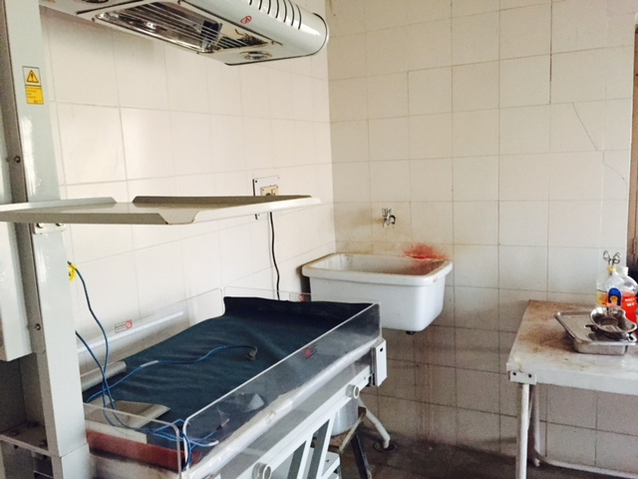
India’s initiatives
National Health Policy 2017
Indian Public Health Standards
Swachhta Guidelines and Kayakalp Awards (2015)
Swachh Swasth Sarvatra (2016)
Photo/WaterAid India/Arundati Muralidharan
Notes:
HEALTH SYSTEMS STRENGTHENING
Adoption of the Indian Public Health Standards: This defined not only the service package that each facility must provide, but also specified the minimum inputs required to ensure quality of care, in terms of infrastructure, equipment, skilled human resources, and supplies. It was an assurance to the states of financing the gaps between available levels of these inputs and the levels needed to achieve the IPHS norms. A substantial increase in these inputs was driven by facility surveys to identify gaps and then planning and financing to close these gaps.
Quality standards have been defined with respect to clinical protocols, administrative and management processes and for support services. The Operational Guidelines for Maternal and Newborn care published by the Ministry of Health and Family Welfare comprehensively defined such quality standards for RCH care.
Skill gaps and Standard Treatment Protocols: Skill sets and standard treatment protocols required for provide quality RCH services and training packages that would provide these skill sets were designed. These include the Skilled Birth Attendance (SBA) training package for ANMs, the Navjat Shishu Suraksha Karyakram (NSSK) and the IMNCI packages for ANMs, the Home Based Newborn Care (HBNC) for ASHAs, and the Emergency Obstetric Care (EmOC) package for doctors. These training packages also introduced the standard treatment protocols in each of these areas.
Hospital Management Societies (RKS) and untied funds: The mandatory creation of a hospital management society (Rogi Kalyan Samiti) and empowering this body with untied funds has allowed public participation also contributed to improved quality of care. RKS members were trained and sensitized on quality of care issues. Before the onset of NRHM, many states generated funds from user fees, however the untied grants to all public health facilities were made available under NRHM which reduced financial barriers to access of health care. This is clearly evident from the increased utilization of indoor and outdoor services at health facilities
Quality Improvement Programmes: NRHM also supports initiatives for building quality management systems. These range from formation of quality assurance committees which use check lists and periodic monitoring visits to assess quality gaps, to more structured quality management systems leading to a third party audit and quality certification- either using ISO 9001: 2008 or NABH. Till date, 82 facilities have been certified by ISO, nine facilities have been certified by NABH and 446 facilities are under process of certification.

Slide 6
Indian Public Health Standards
Set of uniform standards envisaged to improve the quality of health care delivery in the country
Used as the reference point for public health care infrastructure planning and up-gradation
Guidelines are recommendatory in nature and not mandatory
IPHS for 30 bedded CHC
10,000 litres of potable water per day to meet all the requirements; Storage capacity for 2 days
Gender-segregated toilets
Hand washing facilities in all OPD clinics, wards, emergency and OT areas.
Notes:
Indian Public Health Standards (IPHS) have been developed for Sub-centres, Primary Health Centres (PHCs), Community Health Centres (CHCs), Sub-District and District Hospitals. IPHS are a set of uniform standards envisaged to improve the quality of health care delivery in the country and have been used as the reference point for public health care infrastructure planning and up-gradation in the States and UTs. As per IPHS guidelines, the services that different levels of facilities are expected to provide are grouped under two categories i.e. “Minimum Assured Services” or Essential Services and ‘Desirable Services’. Essential Services should be available at the facility which includes promotive, preventive, curative, referral services and all the national health programmes. The services which are indicated as ‘Desirable’ are for the purpose that States should aspire to achieve for the particular level of the facility. The IPHS guidelines are available in public domain at http://nrhm.gov.in/nhm/nrhm/guidelines/indian-public-health-standards.html
IPHS guidelines are recommendatory in nature and not mandatory. Health being a State subject, the primary responsibility of bringing up facilities to IPHS norms is that of the States government. Under NHM, financial support is provided to States inter-alia to bring up facilities to IPHS norms.

Slide 7
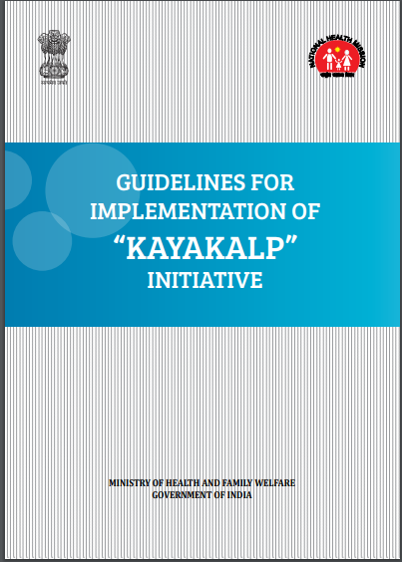
National standards for cleanliness in HCF
Catalysing improvements in health care facilities through the Swachh Bharat Mission
Focus on public health care facilities at primary, secondary and tertiary levels of care
Facilitates infrastructure improvements, systems strengthening, trainings and capacity building
Reward based scheme
Related policy initiative linking improvements in WASH in HCFs with ODF status

Slide 8
Kayakalp awards and implementation guidelines
Hygiene, cleanliness, IPC
Continuous assessment
Best practices for sustainability
Components | 1 | 2 | 3 | 4 | 5 | 6
 | Hospital upkeep | Sanitation and hygiene | Waste management | Infection control | Hospital support services | Hygiene promotion

Slide 9
Kayakalp awards and implementation guidelines
Assessment method
Means of verification
Compliance
Criteria
Full compliance: 2
Partial compliance: 1
Non-compliance: 0
Check point

Slide 10
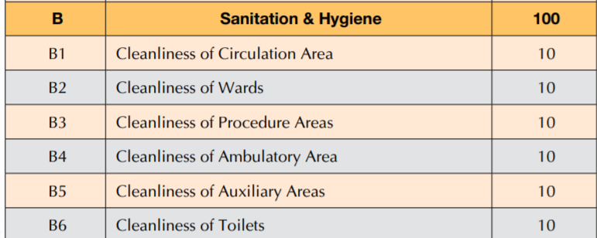
Kayakalp awards and implementation guidelines
Best DH
50 lacs
20 lacs
Best CHC
15 lacs
10 lacs
Best PHC
2 lacs

Slide 11
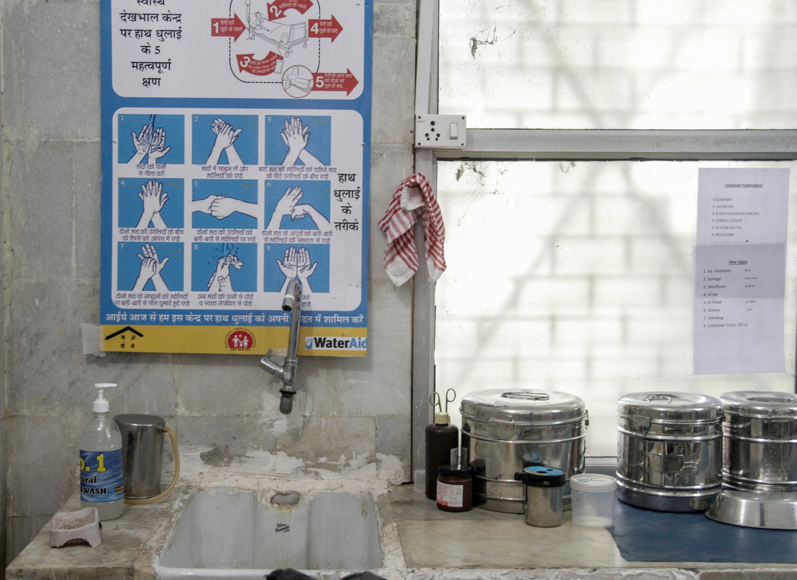
Assess -> Plan -> Execute
Assess
Government assessment tools
Non-government assessment tools- WASH FIT
Review & Plan
Discuss gaps identified
Execute
Allocate adequate budgets to carry out improvements
Community score card
Plan for required improvements, actions
Review progress and achievements against plans

Slide 12
A health systems strengthening approach
Support Government requires
Orientation to standards and assessment tools
Conduct of assessments
Development facility improvement plans
Identification of budgetary allocations
Technical inputs on issues related to water supply, sanitation, hygiene facilities, cleaning, IPC
Standards
Accountability measures
Budget allocations

Slide 13
Accountability mechanisms- The Rogi Kalyan Samiti
Mandated for PHC, CHC, DH
Community representation
Member of Legislative Assembly/Parliament
Health officials
Community leaders
Local government leaders
District officials
Roles:
Ensure compliance to minimal standards
Ensure transparency in fund management
Upgrade health services
Ensure training of health staff
Ensure maintenance of hospital
Generate resources to support hospital

Slide 14
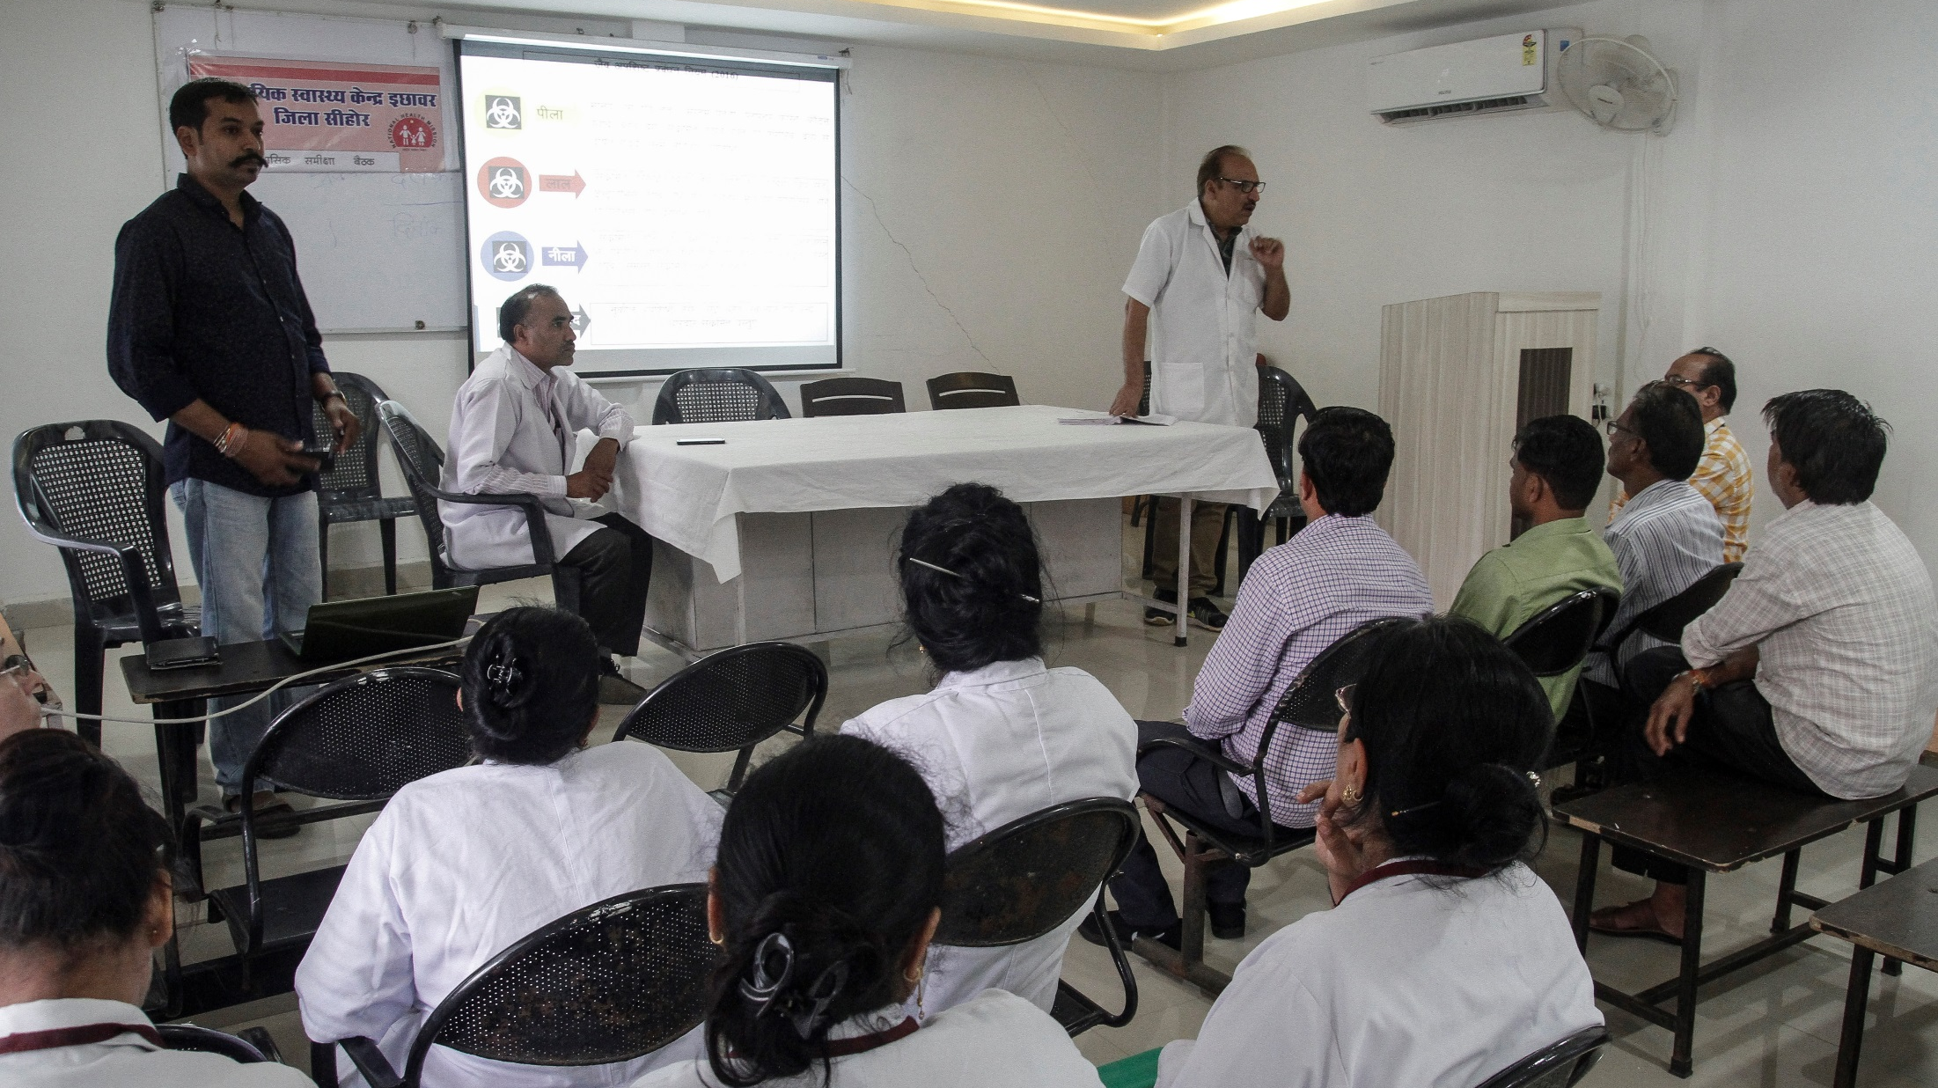
Leveraging the Rogi Kalyan Samiti
Influencing RKS as a member
Conducting trainings on importance of WASH in HCF and their role in making WASH related improvements
Jointly reviewing budgets, identify needs, provide guidance on budgetary allocations, track budgetary allocations and spends
Notes:
Give example of how we work with RKS – to activate and strengthen them,

Slide 15
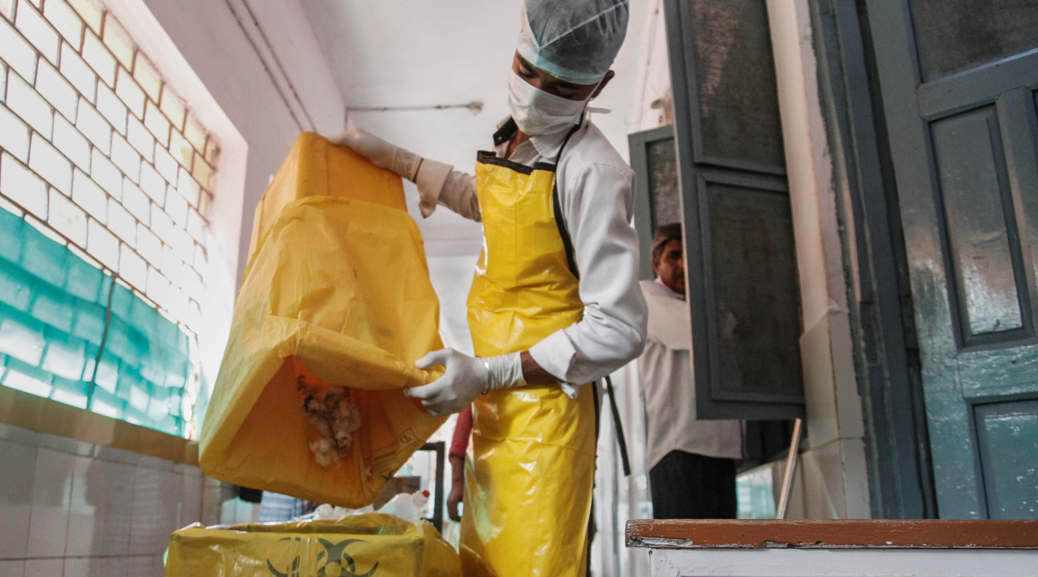
Capacitating Hospital Staff
Facilitate trainings for all cadres of hospital staff in:
Importance of WASH in health care
Hand hygiene
Infection prevention and control
Water quality testing
Role of RKS
Kayakalp guidelines and criteria

Slide 16
Critical gaps
WASH in HCF nominally mentioned in health policy and programs/schemes, even those for maternal and child health
IPHS and Kayakalp are not mandatory
Cash awards given to those facilities that already have good quality WASH facilities
RKS not always active
Health care staff overburdened and lack time for assessments
Cleaner and sanitation workers are contractual and lack training on cleaning procedures and IPC

Slide 17
Conclusion – next steps for India & implications for Nepal
Recognize WASH as a component of quality of care and incorporate into health policy and programs
Support all public health facilities to make improvements – rethink incentive structures to enable this
Incorporate WASH indicators into performance measures of key initiatives delivered through health care facilities
Include education on WASH into pre-service and in-service training of all cadres of health care providers and hospital support staff
Invest in the capacities of RKS/mandated institutions
Build capacities of cleaners and explore how they can be brought on board as permanent staff

